Slide 1
AUTOMATIC DISPENSING MACHINE
STORING
NUT HANDLING
DISPENSING
INDICATIONS
DISPLAY
Storing the nuts based on its size.
Sense nuts
Dispensing nuts
Send notifications
Displaying the no of nuts
Collecting the dispensed nuts
Differentiate the nuts based on size
Machine on/off indication
Displaying size of nuts
Storing unit
Dispensing some quantity 0f nuts
Process completion indication
Handling Unit
Not to dispense damaged nuts

Slide 2
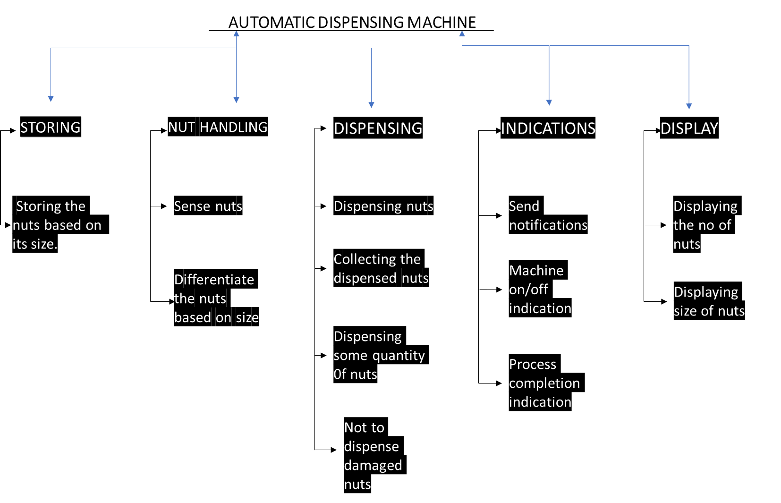
Storing Unit
Handling Unit
Displaying Unit
Indicating Unit
Dispensing Unit

